Slide 1
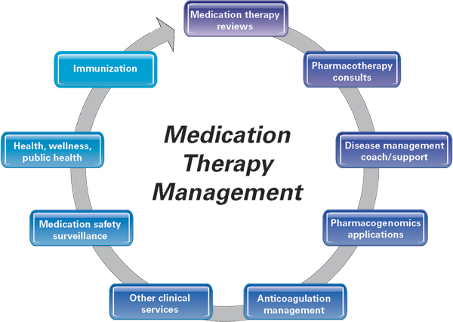
Meeting the Competencies: Innovation in Design and Training Modules for Global Pharmacy Practitioners through Pharmabridge Program
Ansong, Miriam, Pharm.D., E.MBA, Mohan, Linu, MPharm, Agathe Wehri, RPh ; Cedarville University School of Pharmacy & Al Shifa College of Pharmacy
FIP-International Pharmaceutical Federation Conference 2015
FIP-International Pharmaceutical Federation 2015 Conference
background
methods
Core Area 2: Medication Therapy Management
Pharmacists are essential to the health care system in Kerala, India
The current Pharm D program in Kerala, India has significant limitations including; a lack of experiential training in community pharmacy, hospital pharmacy, specialized clinics, public health, inadequate preceptor supervision, and underexposure to modern technologies.
The Pharmabridge program aims to strengthen pharmaceutical services and pharmacy education in developing and transitional countries through coordinated support from established pharmacy settings in more advanced countries.
Preparation:
Goals & outcomes were set, reviewed and agreed upon
Training Manual was created detailing the pedagogical approach to the training modules
List of Modules:
Clinical Practice, Education and Training, Health Information Technology, Research and Certifications programs. Certification programs included: Medication Therapy Management, Health Insurance and Accountability Act (HIPPA), and Immunization
Rationale
List of Locations:
Cedarville University campus and drug information center, three clinical patient care sites, a center for informatics, three community pharmacy practice sites
Image from APhA
Many training sites for Pharmabridge have created unique programs and experiences specific for each location
However, literature is lacking in regards to different pedagogies used for these programs
Linu Mohan P, an assistant professor at Al Shifa College of Pharmacy in Kerala partnered with Cedarville University to accomplish the goals of the Pharmabridge program through multi-disciplinary exposure to pedagogies.
Core Area 3: Experiential Education
Introductory Pharmacy Practice Experience (IPPE)
Advanced Pharmacy Practice Experience (APPE)
P1- IPPE:
Chain or independent Pharmacy
P4: Nine one month rotations in a variety of settings
P3- IPPE: Focused Service Learning
P2- IPPE:
Hospital
Pharmacy
Implementation:
Trainings included at least two modules weekly at the respective sites
Weekly Cross sectional Interview questionnaire was completed to assess the candidate’s experience based on outcomes. The trainers used a similar tool to provide feedback on candidate’s performance. Final assessments of modules outcomes were completed by the candidate at the end of the program to identify areas for implementation in Kerla.
results
objectives
Three Core Areas for implementation in Kerala were identified:
Clinical Practice , Medication Therapy Management(MTM), and Experiential Education
Limitations
Assess the quality and set outcomes in training candidates through a multi-pedagogical modules in an academic-based and institutional pharmacy setting
To develop and implement certain pharmacy practice experiential aspects in Pharm D curriculum in Kerala
Core Area 1: Clinical Practice
Limitations: One month limited time for Pharmabridge
Exposure
Clinical Pharmacists
Ambulatory Care Clinics
Drug Safety
Formulary Management
Specialized Clinics
Investigational Drug Services
conclusions
Acknowledgements
Pedagogical approaches to advanced training and exchange programs can be successfully implemented with institutions abroad.
Implementation of core areas will help develop young professionals with international standards in India.
Agathe Wehri, Cedarville University SOP
References are available upon request

